Slide 1
Synopsis Presentation PHARMACY MANAGEMENT SYSTEM
Under The Sypervision of:
Rabi.N.Panda Sir
Group no. GB11
Team Members-
Diksha Bajpai
Anshika Varshney
Divyam Rastogi

Slide 2
INTRODUCTION
Pharmacy management system is a management system that is designed to improve accuracy and to enhance safety and efficiency in the pharmaceutical store. This program can be used in any pharmaceutical shops having a database to maintain.
Pharmacy management system can make the work easier by giving the details of the medicine when its name is entered. A computer gives the details of the medicine like rate of medicine, and the expiry date and the row and rack location of the medicine. It becomes very difficult in big medical stores to handle the details of all the medicines manually, so by using this pharmacy manage system we can maintain the records of all the medicines .
The main aim of the project is the management of the database of the pharmaceutical shop. This project is insight into the design and implementation of a Pharmacy Management System

Slide 3
Technologies / Software Requirements
Backend: Languages: PHP,MYSQL
Frontend: HTML, CSS, JavaScript
Operating system : Windows 10 based system
Database : MySQL

Slide 4
Hardware requirement
Processor : Intel i3
Ram : At least 4GB
Hard disk : 20GB or more

Slide 5
Modules
Dashboard
Manufacturer
Categories
Medicine
Invoices
Reports

Slide 6
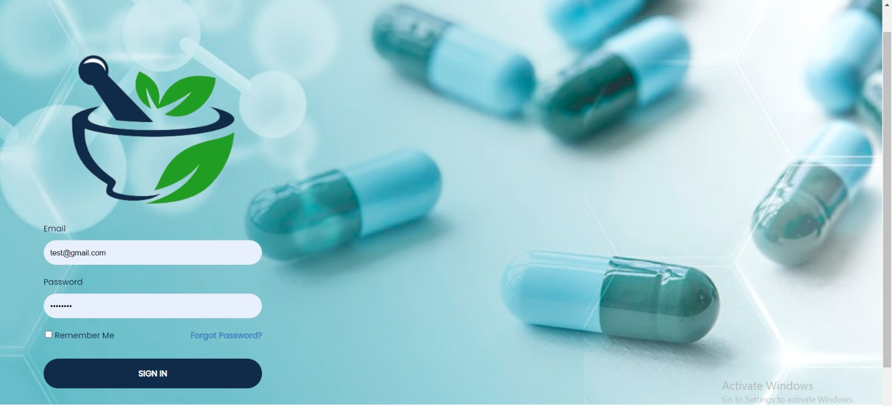
Login Page

Slide 7
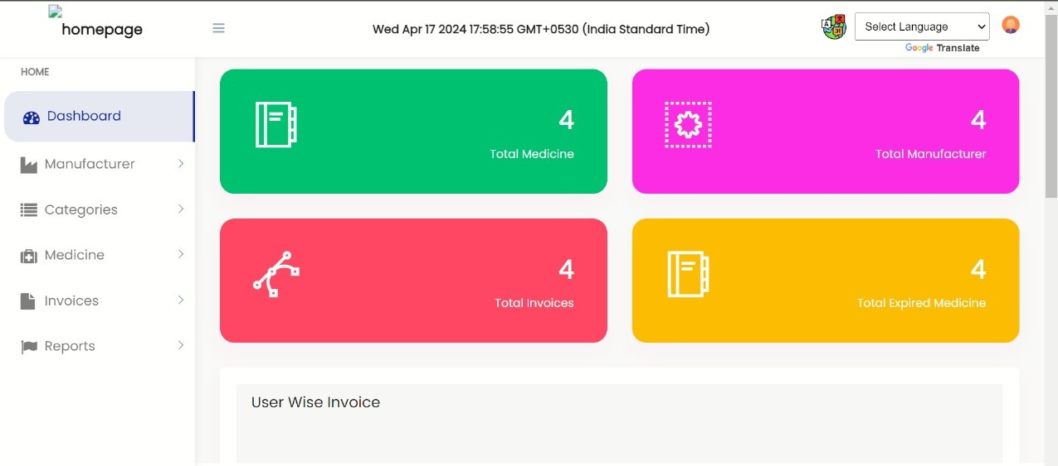
Dashboard

Slide 8
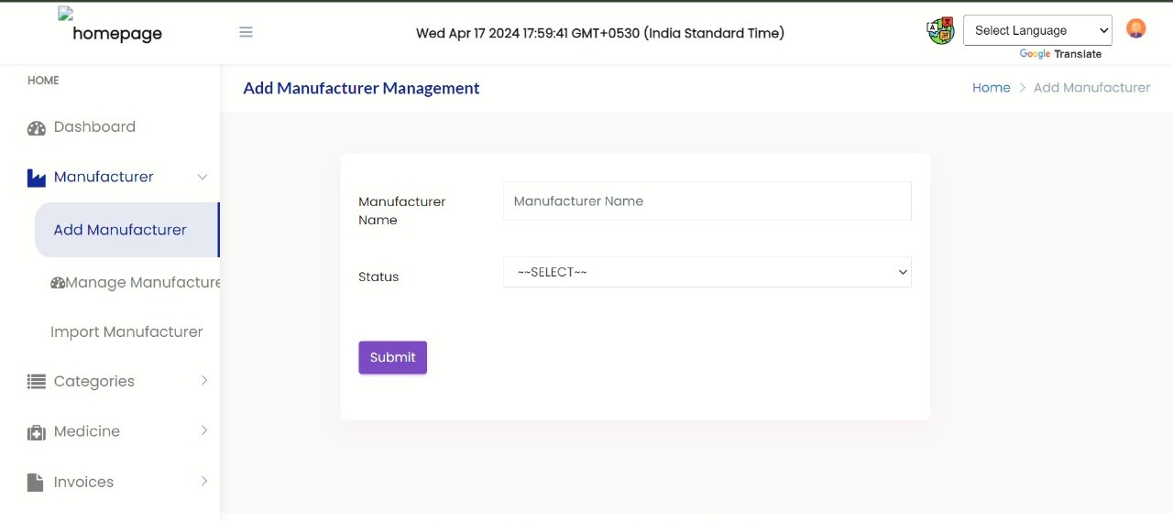
Manage manufacturer

Slide 9
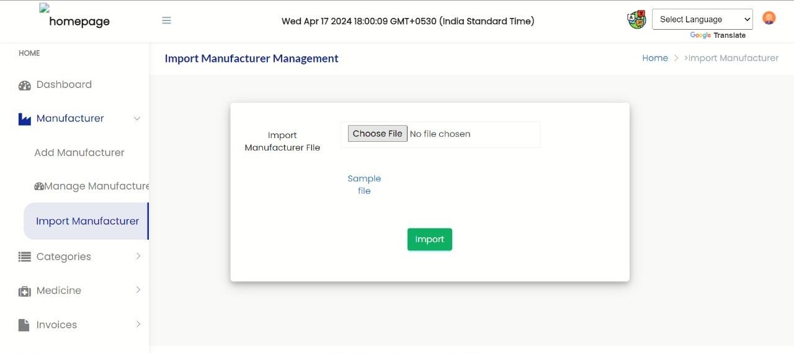
Import Manufacturer

Slide 10
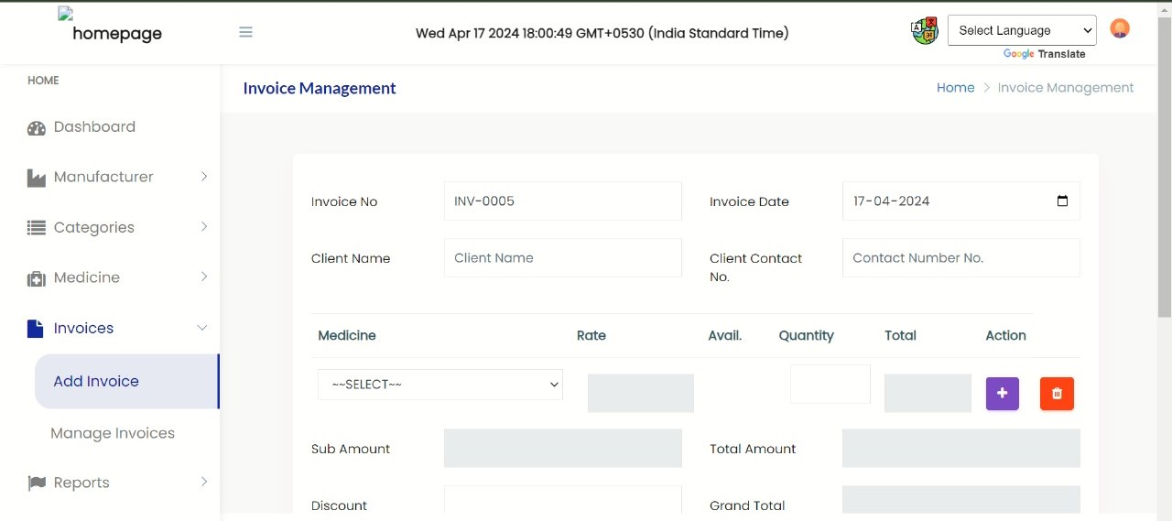
Add Invoice

Slide 11
Thank You!!

